Slide 1
BIO 5300 Proposal Development

Slide 2
Library Resources & Research Life Cycle
Research Proposal
Data Gathering & Processing
Research Content Production
Data Analysis
Research
Dissemination
Research Value Tracking

Slide 3
Research Proposal
Find Grants
Find Collaborators
Conduct background review
Literature Search
OneSearch
Web of Science
Scopus
Subject Databases
Finding Factual Information
Citation Management
[How to Read Papers Workshop]
Define research question/hypothesis
Define project scope/select research methods
Select research techniques
Digital Humanities
Evidence Based Synthesis
Write up proposal
IRB
IUCUC
Data Management Plans

Slide 4
Finding Grants
Grant Forward
Pivot

Slide 5
Library Resources & Research Life Cycle
Research Proposal
Data Gathering & Processing
Research Content Production
Data Analysis
Research
Dissemination
Research Value Tracking

Slide 6
Data Gathering & Processing
Evidence Based Synthesis
Digital Humanities
Finding Existing Data Sets
Finding Factual information
Discovering Archival/Primary Material in Special Collections
Digitization/Scanning
Transcription
High Performance Computing
Automation
Citation Management
Zotero
Endnote
Refworks
Research Data Management

Slide 7
Evidence Based Synthesis
Covidence
Advanced Searching

Slide 8
Library Resources & Research Life Cycle
Research Proposal
Data Gathering & Processing
Research Content Production
Data Analysis
Research
Dissemination
Research Value Tracking

Slide 9
Data Analysis
Evidence Based Synthesis
Digitization
Transcription
Text Analysis
Image Analysis
Geospatial Analysis
Data Visualization
Research Data Management
DMPTool
R and Python Scripting
Statistical Analysis
Statistical Modeling
Through Center for Statistical Consulting
3D Printing

Slide 10
Research Data Management
DMPTool

Slide 11
Data Life Cycle
Planning Research
Collecting Data
Processing and Analyzing Data
Publishing and Sharing Data
Preserving Data
Reusing Data
Notes:
Data Life Cycle: Creating Data, Processing Data, Analyzing Data, Preserving Data, Giving Access to Data, and Reusing Data. The three steps in green are the ones that management plans emphasize, but the details of actual steps are usually taken care of by repository and technical experts who are often librarians with input from the researcher. So I emphasize that the researcher has the most control in are the steps that are in white and that the decisions that are made during these steps can make the green steps easier or harder. I also give the reminder that research process is not linear.

Slide 12
Practical Steps
Know
Organize
Describe
Physical vs. Digital
Raw vs. Reduced vs. Processed Data
File types
File size
Number of files
Backups
Folder structure
File naming convention
Folder/file names
Metadata
README files
researchguides.baylor.edu/datamanagement
https://www.flickr.com/photos/snowmentality/2240235635/
Notes:
A lot of data management is just common sense, but often it still needs to be spelled out.
The researcher needs to know what kind of research method she will use and what research techniques will help her get the data she needs. These data may be born digital or be converted into digital files. She needs to understand that her raw data will be manipulated and analyzed generating new data. The researcher might want open format files in addition to proprietary format files. She will want to have a rough idea of the size and number of data files she will generate so that she has adequate resources to handle them.
Data (and the write-ups too) should be backed up in multiple places and with appropriate security. Remember that a flashdrive and your computer in the same backpack are not really two copies if the backpack is stolen. A consistent folder structure across the different stages of the research makes it easier both in the short and long term. So you don’t want to collect data in a flat folder structure by date, but analyze the data in a hierarchical folder structure by sample. File names should be meaningful and dates should be written year-month-date.
But more than just logical organized folder and file names are a good description of what the data is. Metadata such as thumbnails helps with this, but README files that describe how the file naming convention, what the abbreviation of the headers in a spreadsheet mean, what units of measure were used, how data were manipulated, and what software is needed to read the files are a godsend to a researcher who might want to reuse the data or even the researcher herself after a semester away from the project. README files also let us know whether the raw, reduced, or processed data are the files being preserved.
So, that’s data management in a nutshell. If you want see a copy of the powerpoint I actually use for the workshop, you can use this link.

Slide 13
Methods vs. Techniques
Research Methods
Research Techniques
Re-Analysis/Meta-analysis
Observational
Experimental
Simulation
Theoretical
Using an NMR
Programming in Fortran
Running a Western blog
Synthesizing chemicals
Mapping in ArcGIS
Notes:
So different research methods would include re-analysis/metaanalysis, observational, experimental, simulation, or theoretical. Research techniques might be learning how to use a particular program or piece of equipment. Your research plan might be influenced by what materials and techniques you have available to you.

Slide 14
Generating Data
Research Methods
Data Outputs
Re-Analysis/Meta-analysis
Observational
Experimental
Simulation
Theoretical
Photographs
Blood samples
Computer programs
Field Notebooks
Graphs of Spectra
Notes:
So different research methods (re-analysis/metaanalysis, observational, experimental, simulation, or theoretical) will lead to different types of data creation. Your project might even use more than one kind of method and technique. If you’re doing a re-analysis, you will really appreciate it when previous researchers have had good data management plans otherwise you wouldn’t be able to reuse the data. Observational or experimental data might result in photographs or physical samples or notebooks. You will also have measurements from different type of instruments that you use—some of might be automatically recorded; other you might have to write down by hand. Simulations generate the programs that run the simulations and the actual simulation (inputs and outputs) themselves. Theoretical studies tend not to have as much data.

Slide 15
Recording Data
Data Outputs
Data Types
Photographs
Water samples
Computer simulation
Lab Notebooks
Graphs of Spectra
Physical specimens
Paper
Electronic files
Notes:
Some data outputs like rock or biological samples are physical. Some like photographs or notebooks or graphs might be on paper or as electronic. But mostly likely you will have electronic files.

Slide 16
Organizing Data
By time
By experiment
By sample
By instrument
By user
Folders
Files
https://loveyourdata.wordpress.com/tuesday/
Notes:
So, when you organize your data you need to think about how you want to organize your data and how that will effect your folders and your files. You need to be consistent. You can’t organize half your project (i.e. creating data—this step) one way, and the other half of your project (i.e. processing data—the next step) a different way. This website is where some of these ideas come from.

Slide 17
Folders
Piling
Filing
Flat folder structure
Every folder is at the same level
More descriptive file/folder names are needed
Hierarchical folder structure
Folders are nested inside each other
A README file is needed to describe which files are in which folders

Slide 18
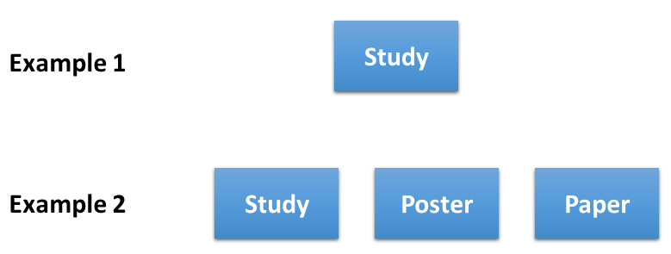
Piling

Slide 19
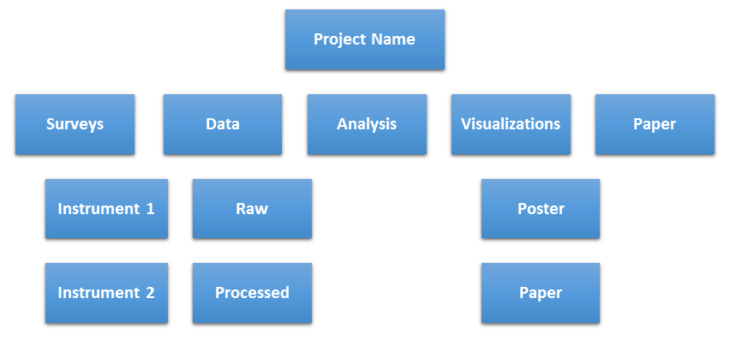
Filing

Slide 20
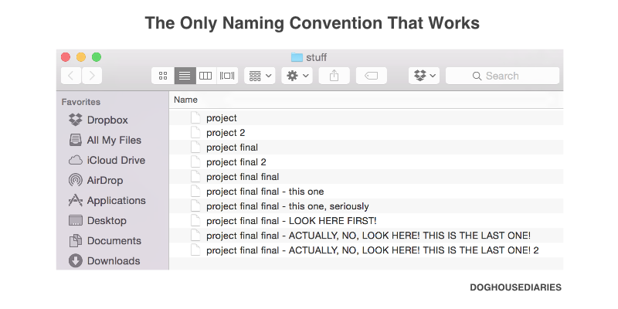
Folder and File Names
Make it meaningful
Provide context so it will be a unique file
Use only one period and before the file extension
Dates should be formatted like this: YYYYMMDD (e.g., 20150209)
Put dates at the beginning or the end of your files, not in the middle, to make it easy to sort files by name
OK: DST_FileNamingScheme_20151216 20151216_DST_FileNamingScheme
AVOID: DST_20151216_FileNamingScheme
For sequential numbering, use leading zeros.
1-10 should be numbered 01-10
1-10 should be numbered 001-010-100
Do not use special characters: & , * % # ; * ( ) ! @$ ^ ~ ‘ { } [ ] ? < >
Some people like to use a dash (–) to separate words
Others like to separate words by capitalizing the first letter of each (e.g., DST_FileNamingScheme_20151216)
http://thedoghousediaries.com/5964
Notes:
Be Clear, Concise, Consistent, and Correct
It should make sense to you and others working on the project (even months from now)
A unique file name will allow people to recognize what it is if moved to another location
Putting the year first in dates allows the computer to automatically sort the files by date when sorting alphabetically

Slide 21
Maintaining Data
Backups
Security
Multiple backups
External hard drive
Flash drive
Cloud
Box
OneDrive
Email
Anonymization
Password protection
Un-networked computers
Notes:
Maintaining data while you’re actively working on a project is a bit different from maintaining the data after you’re done with the project
Probably while you’re working on something you want at least 3 copies. You need to make sure that your backup is not in the same place as computer. If your computer and flash drive are both in your backpack and your backpack is stolen, both copies are gone. The flashdrive is not really a backup. One advantage of Box is that it has automatic versioning so you don’t have to worry about accidentally overwriting your files.
Security is especially important if you have data from people. You need to keep track of how you’re anonymizing the data (i.e. README) and you need to make sure that your files/computers are password protected. In really extreme circumstances, you might want to make sure that is not connected to the internet. The security on Box is much higher than on dropbox or google drive which is another plus.

Slide 22
Preserving Files
File number and sizes
File types
Non-proprietary (.txt, .csv/.tsv, .jpg, .jpg2, .tif, .pdf)
Common proprietary (Office files, SPSS files, etc.)
Less common proprietary (Adobe files, etc.)
Exclusive
Notes:
In order properly ensure that data can be archived, the data manager needs to make sure he/she has the resources to archive the data. Most projects don’t need any extra resources; but if there an extraordinary number of files (even if the files are small), special processes might need to be used. Or if the files are extraordinarily large (i.e. video files) then extra hardware might be needed. It might make sense to generate thumbnails or clips or sampled files.
File types are important at this point. You want to make sure that years from now that people/computers can still read your files. There are certain types of files that any computer can read. And there are other types of files that you need to have certain (very expensive) software to read. Or sometimes, when they revise software, the new revision cannot read the old files from the same program. You might want to have your data in different types (i.e. excel spreadsheet with all the formulas and a CSV with a README that describes how each column was calculated)

Slide 23
Documentation
How much/which data do you want to archive
Reduced vs. raw data
Redacted data
Metadata
Thumbnails
README
Notes:
Your data is useless unless people know what it is. Metadata is information about your data or project but not the data itself. Metadata about a book is the information you find about the book in the catalog but not the book itself. Thumbnails are a type of metadata which are useful for visual data.
It is also important to include the READMEs that you created.

Slide 24
Describing Data
README files
Text file
Naming and file convention
Explain any abbreviations
Describe the contents of the file
Spreadsheet columns
Headers
Notes:
File and Folder names should be descriptive, but sometimes you need README files also
A text file that can be read by any computer
It can describe the naming and file convention
Describe the contents of the file—especially good for spreadsheets—can explain what’s in the columns and what units are being used. Can explain how different columns are calculated. It can also explain the header information in other data files

Slide 25
Library Resources & Research Life Cycle
Research Proposal
Data Gathering & Processing
Research Content Production
Data Analysis
Research
Dissemination
Research Value Tracking

Slide 26
Research Content Production
Type of Research Content
Abstracts
Articles
Conference Papers
Lesson Plans
Portfolios
Posters
Presentations
Websites
Copyright/Fair Use
Data Visualization
Data Management
3D Printing
Writing Group Meeting Space
Writing Abstract Workshop
Creating Posters Workshop
Summer Teaching Fellows Program

Slide 27
Library Resources & Research Life Cycle
Research Proposal
Data Gathering & Processing
Research Content Production
Data Analysis
Research
Dissemination
Research Value Tracking

Slide 28
Research Dissemination
Publications
Presentations
Finding publication venues
Impact factor
Open access
“Predatory” Journals
Publication Agreements
Copyright Issues
Citation Management
Plagiarism Check
BEARdocs: Institutional Repository
BEARdata: Data Repository
Subject repositories
Practice Space

Slide 29
What is the Most Common Source?
Book (20)
Webpage (2)
Anglican Theological Review (1)
Canadian Baptist (1)
Child Welfare (1)
Feminist Theology: The Journal of the Britain & Ireland School of Feminist Theology (1)
Journal of Religion & Abuse (7)
Psychotherapy Networker (2)
Religion in the News (1)
Notes:
So, of course, you should ask your advisor for suggestions but she’s on sabbatical this semester so she hasn’t been very good at getting back at you. The next logical step is to look at your sources and see what are the most common sources you used—if there are some that crop up a lot, those might be good candidates for you to submit to. On this slide I’ve listed the references from a paper written by the dean of social work. She had 36 references. Most of them are to books, and 2 of them are to webpages. But she still has references to 14 journal articles. What was the most common journal she referred to? Where do you think this paper was published?

Slide 30
Where did she publish?
Garland, D. R. (2006). When wolves wear shepherds' clothing: Helping women survive clergy sexual abuse. Journal of Religion and Abuse, 8(2), 37-70. doi:10.1300/J154v08n02_04

Slide 31
Relevance
Nature
JACS
ACS Catalysis
Studies in Surface Science and Catalysis
Book
Communication Research
Media, Culture, and Society
International Journal of McLuhan Studies
Notes:
So, you’ve looked at your sources and you’ve narrowed down the possible journals to three or four. Which would be the best journal to start with? You need to consider Relevance and Accessibility.
You need to decide whether to submit to a general journal in your field or one in a more specific subfield or even a very general journal.
For example, let’s say you study how chemicals catalyze on surfaces so studies in Surface Science and Catalysis would be relevant. But so would just a journal that focuses on catalysis or chemistry or just science in general.
In the humanities or social science, you might be a McLuhan scholar (by the way, our libraries symposium in 2 weeks will be on one of McLuhan’s books Understanding Media). You can see how in the same way, you can find journals that are more specific or more general but still relevant to your topic. Although in the humanities and social science probably the most general publishing venue would be a book and not a journal. And how to publish a book is a whole other topic.
The key to remember is that the significance of your results needs to match the significance of the journal. Would people outside your discipline be interested in your results? Other scholars within your discipline? Or only people in your lab and labs like yours? One caveat—some professors might advise you to always start at the general discipline level and work your way down as your article gets rejected.

Slide 32
Relevance
Significance of your results needs to match the significance of the journal
Would people
outside your discipline be interested in your results?
other scholars within your discipline?
only people in your lab and labs like yours?
Some professors might advise you to always start at the general discipline level and work your way down as your article gets rejected.

Slide 33
Accessibility
Basic Information
The Serials Directory http://search.ebscohost.com/login.aspx?authtype=ip,uid&profile=ehost&defaultdb=ser
Open Access Journals
Directory of Open Access Journals http://doaj.org/
Indexing
Ulrich’s Web Global Serials Directory http://ulrichsweb.serialssolutions.com/
Notes:
But not all general or even subject-specific journals are equal. In order to be accessible people need to be able to find your article and be able to read it once they find it. You worked hard on your research and you want as many people as possible to know about it.
Since most people uses databases to find articles, you want to make sure that the journal is indexed in all the databases relevant to your field. Ulrich’s web is a listing of almost all journals and generally a good source on where a journal is indexed.
Libraries are also most likely to subscribe to journals that high impact. The more libraries that subscribe to the journal, the more likely your article will be read. There are different ways of measuring impact but usually they are based on how often articles in a journal are cited. Examples include Impact Factor, SNIP, and SCImago Journal Rank. Going over these is a topic unto itself, but you can read more about it these two websites. They do similar things but are based on two different corpuses of work. Your professor may also suggest that you start with the journal with the highest impact and move your way down as the article gets rejected.
You might also want to consider how much time it will take for your article to be published. This time can depend on how often a journal is published, their acceptance rate, and their average time for review and review process. In the humanities and social sciences, these websites can give you some information. But also check the websites of the individual journals.
Finally, Open Access Journals do not require subscriptions so they tend to be more widely read and often more cited. However, they require the authors to pay for the publication and there are scammers out there so be careful. Although there are plenty of reputable open access journals that are not on the list, all the journals listed in the directory of open access journals are reputable. Contact your librarian if you have questions before you submit to an open access journal.

Slide 34
Accessibility
Impact
Journal Metrics www.journalmetrics.com
Thomson Reuters Journal Citation Reports www.jcr.incites.thomsonreuters.com
Scimago Journal Rankings http://www.scimagojr.com/journalrank.php
Time
Cabell’s Directory of Periodicals http://www.cabells.com/memberarea.aspx
MLA Directory of Periodicals http://search.ebscohost.com/login.aspx?authtype=ip,uid&profile=ehost&defaultdb=kah
Notes:
But not all general or even subject-specific journals are equal. In order to be accessible people need to be able to find your article and be able to read it once they find it. You worked hard on your research and you want as many people as possible to know about it.
Since most people uses databases to find articles, you want to make sure that the journal is indexed in all the databases relevant to your field. Ulrich’s web is a listing of almost all journals and generally a good source on where a journal is indexed.
Libraries are also most likely to subscribe to journals that high impact. The more libraries that subscribe to the journal, the more likely your article will be read. There are different ways of measuring impact but usually they are based on how often articles in a journal are cited. Examples include Impact Factor, SNIP, and SCImago Journal Rank. Going over these is a topic unto itself, but you can read more about it these two websites. They do similar things but are based on two different corpuses of work. Your professor may also suggest that you start with the journal with the highest impact and move your way down as the article gets rejected.
You might also want to consider how much time it will take for your article to be published. This time can depend on how often a journal is published, their acceptance rate, and their average time for review and review process. In the humanities and social sciences, these websites can give you some information. But also check the websites of the individual journals.
Finally, Open Access Journals do not require subscriptions so they tend to be more widely read and often more cited. However, they require the authors to pay for the publication and there are scammers out there so be careful. Although there are plenty of reputable open access journals that are not on the list, all the journals listed in the directory of open access journals are reputable. Contact your librarian if you have questions before you submit to an open access journal.

Slide 35
the journal with the biggest interested audience for your research

Slide 36
Library Resources & Research Life Cycle
Research Proposal
Data Gathering & Processing
Research Content Production
Data Analysis
Research
Dissemination
Research Value Tracking

Slide 37
Research Value Tracking
Academic Identity
Academic Reputation
ORCID
Academic Social Networking
Academic Social Media
Bibliometric training and reviews
Journal Metrics
Impact Factor
Publication Metrics
Citation counts
Library holdings
Author Metrics
H-Index

Slide 38
Identification
Using ORCiD to help with
http://researchguides.baylor.edu/ORCID
http://www.orcid.org

Slide 39
The Problem
The research community has lacked the ability to link researchers with their professional activities.
As a researcher, you want to
eliminate name ambiguity, distinguishing you from other researchers and ensuring proper attribution.
ensure your work is discoverable and connected to you throughout your career;
minimize the time you spend entering repetitive data online; and

Slide 40
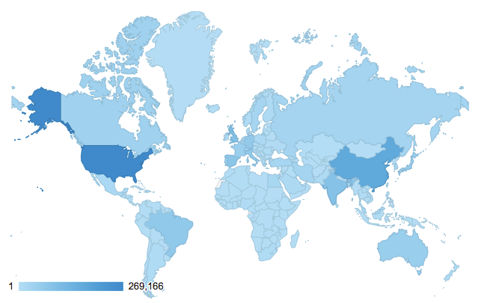
How can ORCID help?
ORCID provides you a unique and persistent personal identifier that connects you and your research activities throughout your career.
More than 1 million iDs issued to date
Registry use is international
Notes:
Notes for presenter:
ORCID is unique in its ability to reach across disciplines, research sectors and national boundaries and in its cooperation with other identifier systems.
The ORCID identifier is a key component that supports system-to-system interoperability.
ORCID is a non-profit organization, working in collaboration with other stakeholders in the research community.
ORCID is an open, collaborative effort. Our source code is open for other institutions to use.
Design notes:
The number of iDs issued increases regularly. Registry statistics are updated weekly and are available at https://orcid.org/statistics.

Slide 41
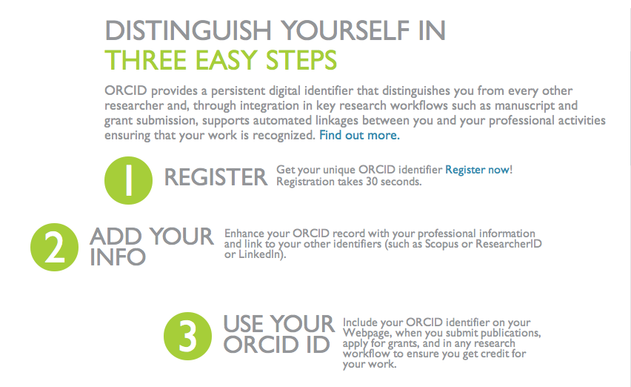
Distinguish Yourself
Notes:
Notes for presenter:
Here are the three simple steps you should take to enjoy all of the benefits. The following slides provide additional detail and support.
You can go to http://orcid.org to begin this process.

Slide 42
Improve Discoverability & Reduce Repetitive Data Entry
Funders
Grant submission systems
Awardee databases
Universities
Integrating with:
Researcher information systems
Institutional repositories
Grants & contracts
HR systems
And creating records for students & faculty
Professional societies
Membership renewal
Publishing and meeting registration processes
Publishing & repositories
Publishers are integrating into manuscript submission and author/reviewer databases
Repositories linking with deposition, search and updating
Both are linking internal ID with ORCID record
Notes:
Notes for presenter:
Through linkages with other systems, ORCID reduces repetitive data entry associated with the increasing diversity of research information systems with which you interact.
By creating links among your professional activities, ORCID improves discoverability, allowing you to easily share your research work.
ORCID iD stays with you your entire career.
Embedding is widespread:
University CRIS/research information, or researcher profile systems
Manuscript submission
Grant applications
Linkage with repositories
Linkage with other IDs

Slide 43
Research Value Tracking
Academic Identity
Academic Reputation
ORCID
Academic Social Networking
Academic Social Media
Bibliometric training and reviews
Journal Metrics
Impact Factor
Publication Metrics
Citation counts
Library holdings
Author Metrics
H-Index

Slide 44
Bibliometrics
Traditional Metrics
Altmetrics
Book metrics
Journal metrics
Author metrics
Article metrics
Notes:
Like it or not, as an academic you will likely be evaluated based on your publications and citations. Being aware of how these different measures work will help guide some of your choices in where and what and how to publish. Of course, you shouldn’t try to “game the system,” but you can make strategic decisions.
I’ll talk about both traditional metrics which for now is what hiring and tenure committees will base part of their decisions on and altmetrics which currently are not as influential in hiring and promotion, but we feel that might change in the next 5-10 years. Traditional metrics are generally based on citations and other scholarly references. Altmetrics generally involve mentions in social media and downloads.
We’ll look at the metrics about your books, the individual journals you publish in, each article you write, and your cumulative influence of your research. I will just mention the different metrics but because of time I will not be able to go into detail on how they are calculated.

Slide 45
Books
Traditional Metrics
Altmetrics
Bibliographies
Book reviews
Library ownership
Amazon rating
Notes:
Increasingly book chapters can be tracked the same way that articles can be tracked.
But traditionally, the mark of success for a book was to be listed in a bibliography for the discipline and to have the book reviewed in as many journal as possible.
But alternatively, we can count how many libraries (academic and public) own your book and also even look at the Amazon rating for a book.

Slide 46

Journal Metrics
Traditional Metrics
Altmetrics
Impact Factor
Eigenfactor
H Index
Sum of article altmetrics
Notes:
It’s not always easy to decide where to submit articles, but in general you will enhance your academic identity by publishing in a “good” journal.”
Some journals “count” more or are “ranked” higher.
Impact Factor is one of the main metrics for journals and is the average number of citations received per paper for a given journal during the preceeding two years.
A lesser known metric is Eigenfactor which measures of how much time readers spend with a journal and is greatly influenced by the number of articles in the journal.
One metric that is starting to grow in popularity is the H Index which is also highly influenced by the number of papers published.
Altmetrics for a journal is simply the sum of all the altmetrics of each of the articles. You may have seen the altmetric torus (from the actual company altmetrics) which gives the total number of “mentions” and the colors of the torus indicate what kind of “mentions”

Slide 47
Article Metrics
Traditional Metrics
Altmetrics
Journal
Citations
Downloads/Views
Tweets
Facebook mentions
Google posts
Mendeley shares
Newsbriefs
Blog posts
Notes:
So each individual article that you write will also be evaluated.
For traditional metrics,
First, your article will be judged based on what journal it is published in. And we just went over how journals are evaluated.
Secondly, it will be judged based on the number of citations it has. You generally want more citations to enhance your academic reputation. But keep in mind that different databases will give different citation numbers.
For almetrics, the main measurement is at the article level which is why sometimes people refer to article metrics. So, these include downloads/views (both from the publisher’s website and repositories), social media mentions, and more formal newsbriefs or blog posts about the article.

Slide 48
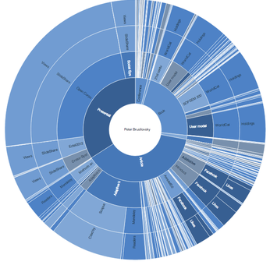

Author Metrics
Traditional Metrics
Altmetrics
Total # of papers
Total # of citations
Citations/paper
H-Index
Sum of article altmetrics
Notes:
Traditional author metrics are a summary of your work and their influence. People often list these metrics on their CVs.
Some of them are pretty obvious. The total number of papers and the total citations and the average citation per paper. But the total and average citations can be greatly influenced by a single paper if it has an overwhelming number of citations.
H-index gets around this problem somewhat, but it is highly influenced by the number of papers that have been written. When comparing people, I often normalize it by academic age (or the years since receiving a PhD).
H-index is the number of papers (h) that have been cited at least (h) number of times.
For altmetrics, similar to the journals, the altmetrics for authors are based on the sum of their articles. Plum analytics is one company which tracks the altmetrics for individuals and they have this PlumPrint widget for articles and the sunburst for individuals.

Slide 49
Library Resources & Research Life Cycle
Research Proposal
Data Gathering & Processing
Research Content Production
Data Analysis
Research
Dissemination
Research Value Tracking

